Slide 1



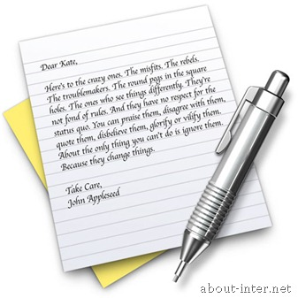

Application of XML
PROs of XML
Extensibility
Plain text
Exchange of data
XML

Slide 2
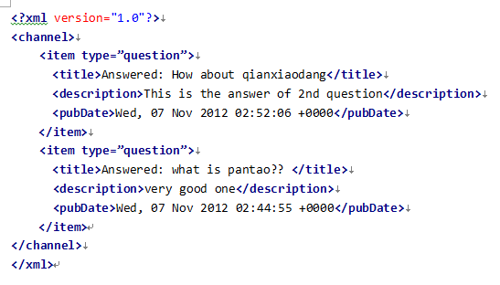


PROs of XML
Unicode(run the HTML with and without UTF-8)
Easy to read by human: self-documenting, tag and nest
”≥:Tè≥•ö¨H2z+qß”¨˘äÈeùT‚iß¢™±ä pdT Ha#¨Ë:b∞(2Pã‘òj"∏%$ímS\YuLùG+,9^ùLá
Wû≥/©gäkFLªM ÉD§0êWn Ú—pBH8·Ú÷N∂c¨ÈXÅmƒ˜+·S‘ŸÊ°+°e√ÕÀNV¢√
∏t£dí8 á»4rùtå:ﬁí›&P]ì* íÒ÷Ωd◊K)50c®†ÈÉ∆ ÙÿóÏÿﬂ‚ƒÖ]è,

Slide 3
CONs of XML
low efficiency
space(tag and tag)
time(compare to binary)(比较真实数据)

Slide 4
CONs of XML
So-called easy to read?
Read by human? How about this long
Debug by human? How about using tool
We don’t need this nowadays!!
So, what are we going to do with XML
High Extensibility
Highly structured
Efficiency doesn’t matter

Slide 5
So better use in:
Structured data store
Tree model of XML data(UI of andriod)
Exchange of Data
Format base on XML:RSS, eBXML,SVG,SMIL

Slide 6
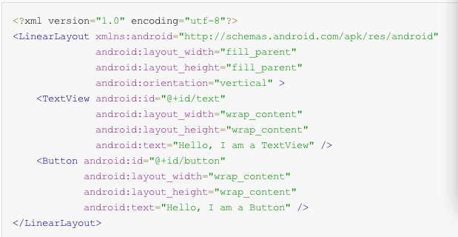

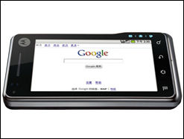
Application of XML
Structured data store
Tree model of XML data(UI of andriod)

Slide 7



Exchange of Data
Format base on XML:RSS, eBXML,SVG,SMIL

Slide 8
NEWs
Really Simple Syndication
Also called News feed
Media
Products
ME
Music
Novel
ADs

Slide 9
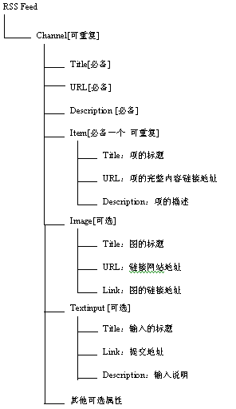
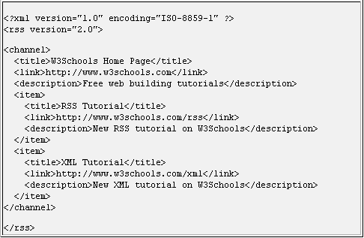

Slide 10

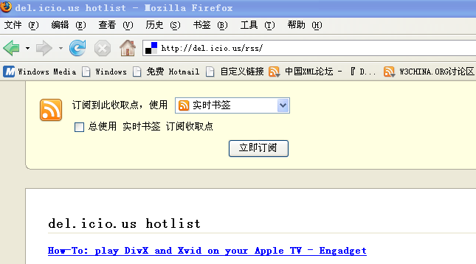
How we use on web: e.g. Google reader
How we use on our project?
Lets try it together!

